Slide 1



Baburaoji Gholap College (BGC)
A Project Presentation on
“Resort Navigator”
Presented by Mr.Aryan Takale &
Mr.Yash Gaikwad
‹#›

Slide 2

Outline
Introduction
System Analysis
Implementations details.
System Design
UML Diagrams
User Interface
Conclusion
‹#›

Slide 3
Introduction
Motivation:-
Developing a “Resort Navigator” application simplifies operation, enhance guest satisfactions, and increases revenue
Problem Statement:-
The problem we aim to solve with the resort navigator is the difficulty guests experience in navigating our resort's complex layout, which results in guest frustration, longer travel times, and diminished overall guest satisfaction.This consumes more time, force and costs money.
‹#›

Slide 4
Introduction (Cont’d…..)
Purpose / Objective and Goals:-
The purpose or objective of developing a resort management system is to efficiently and effectively manage all aspects of the resort's operations to enhance guest experiences, optimize resource allocation, and increase profitability.
Literature survey:-
We have visited some local resort and hotels and by examine their working process is semi-manual, slow and too lengthy.
‹#›

Slide 5
Introduction (Cont’d…..)
Project Scope and Limitations:-
Resort Navigator as a third-party application aims to provide a centralized platform for multiple resorts to manage their operations and bookings efficient.
It is only web-based application.
‹#›

Slide 6
System Analysis
Project perspective, features.
Reservation Management:
Streamlined online booking and reservation system.
Easy check-in and check-out processes.
Room and Service Management:
Efficient room service and maintenance tracking.
Comprehensive management of resort amenities.
‹#›

Slide 7
System Analysis(cont.)
Billing and Payment:
Automated billing and secure payment processing.
Integrated invoicing for guest services.
Customer Relationship and Reporting:
Personalized guest profiles and communication tools.
Detailed reporting and analytics for better decision-making.
‹#›

Slide 8
System Analysis(cont.)
Security and Compliance:
Robust data security and compliance measures.
Integration with security systems for guest safety.
Stakeholders:
- User : – any person.
- Admin
‹#›

Slide 9
Implementations Details
Hardware requirements:-
Processor: - i5 10th generation and Above
Operating System: - Linux, Windows, Mac OS
RAM: - 4GB and above.
Hard Disk: -60GB and above.
Software requirements
Frontend: - React.js.
Backend: - MYSQL, Spring Boot.
‹#›

Slide 10
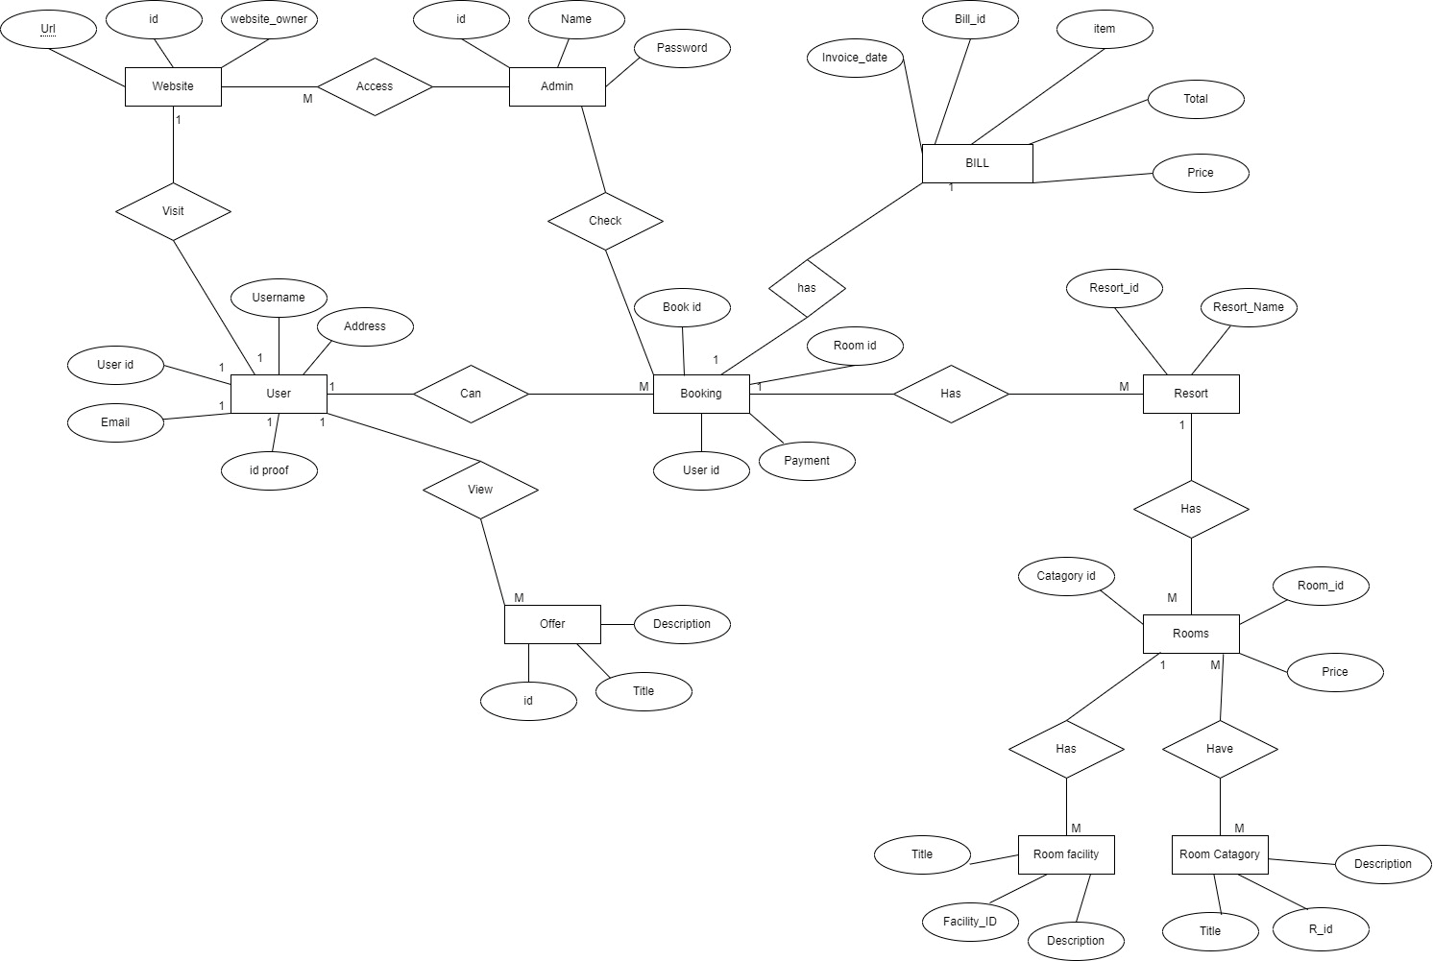
System Designs
Entity Relationship Diagram
‹#›

Slide 11
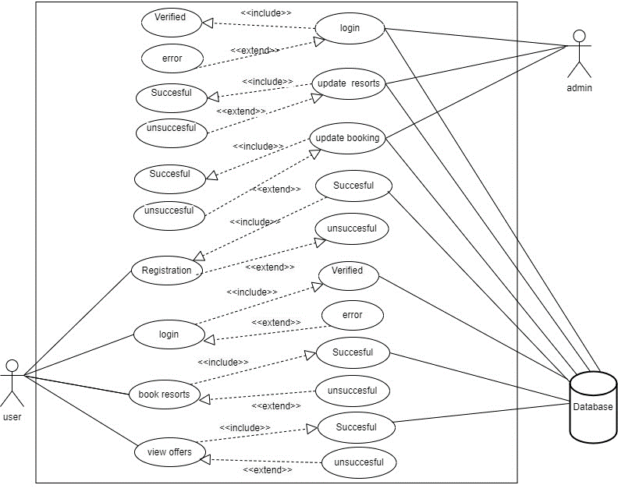
System Designs(cont..)
Use Case Diagram:-
‹#›

Slide 12
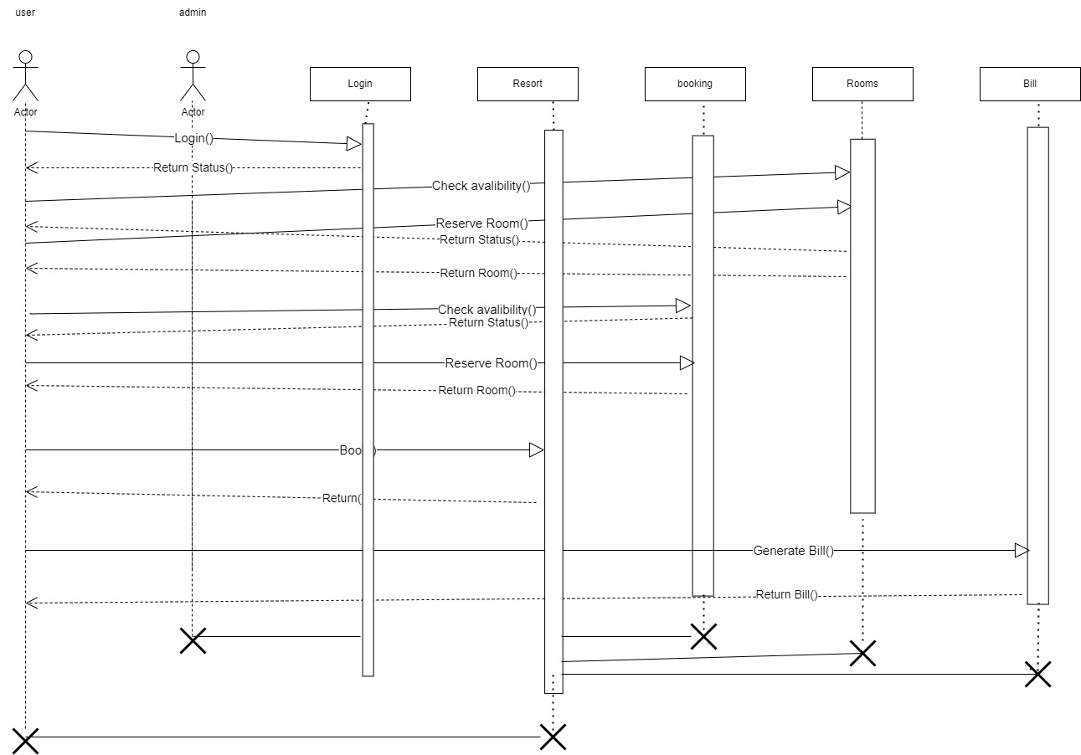
System Designs(cont..)
Sequence Diagram:-
‹#›

Slide 13
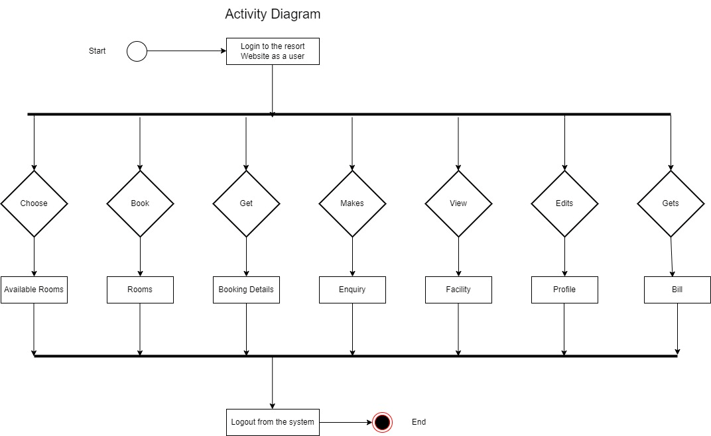
System Design(Conti..)
Activity Diagram:-
‹#›

Slide 14
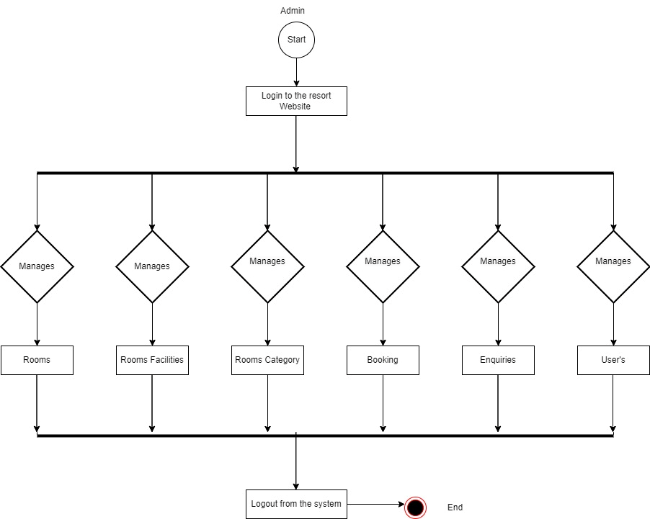
System Design(Conti..)
Activity Diagram:-
‹#›
‹#›

Slide 15
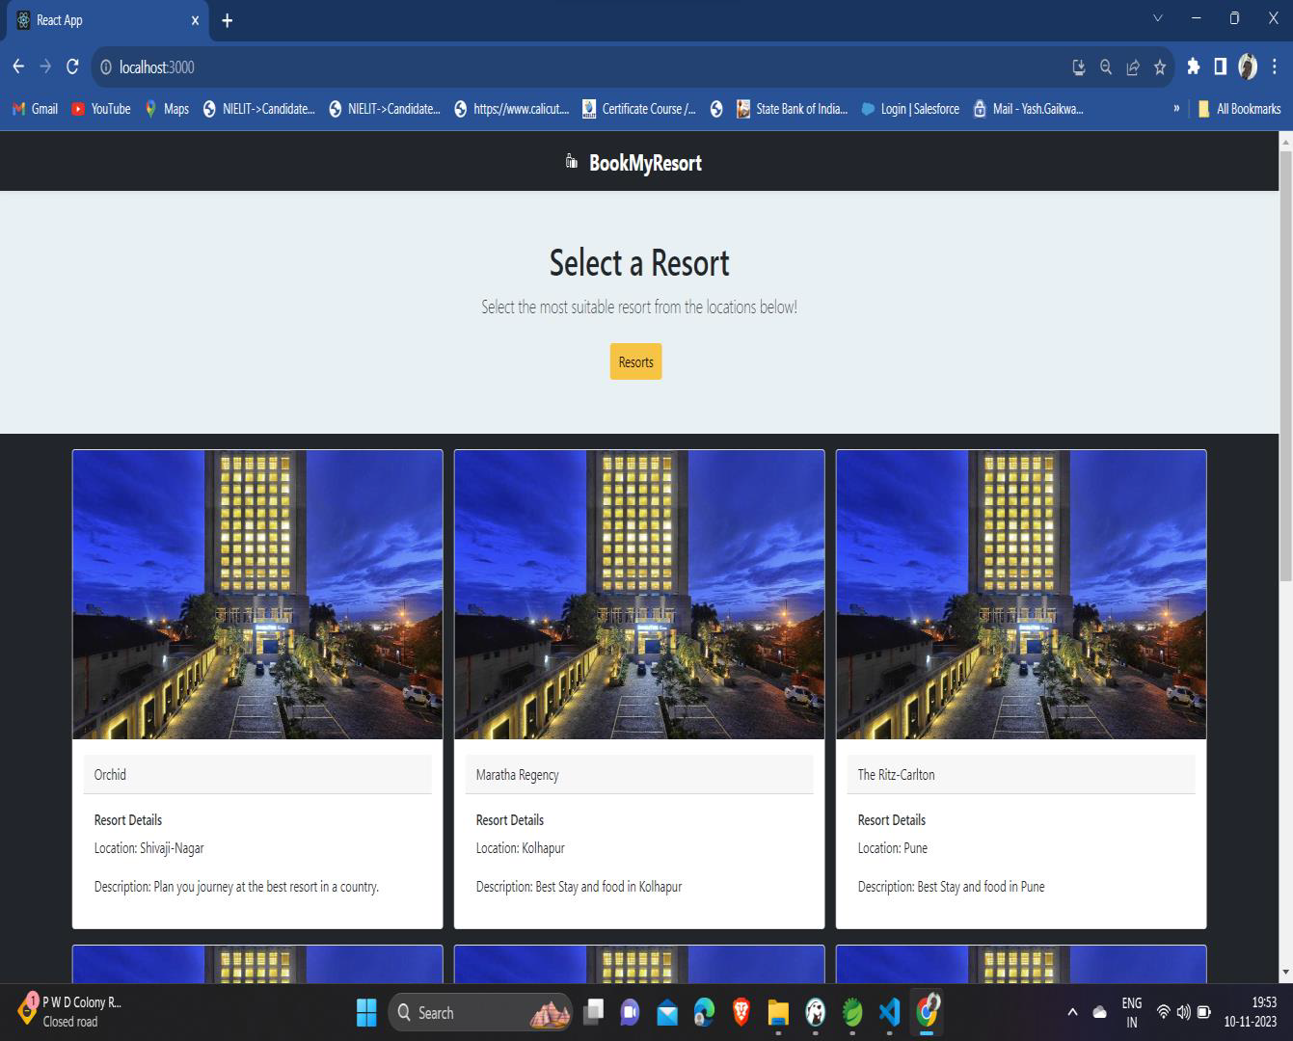
User Interface
Input and Output Screen:-
‹#›

Slide 16
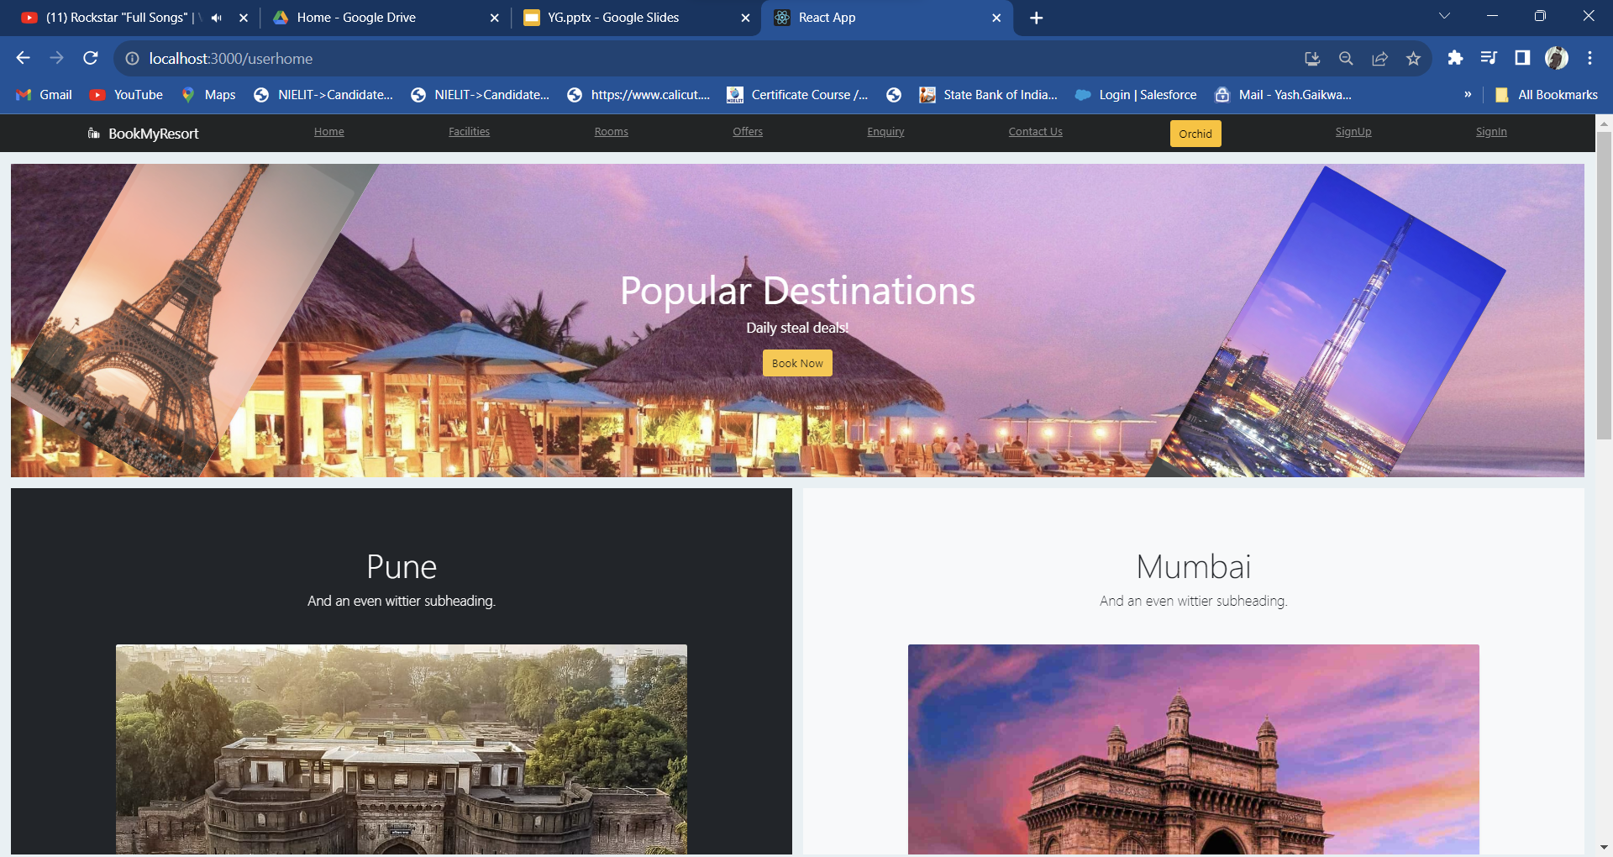
User Interface(Conti..)
‹#›
‹#›

Slide 17
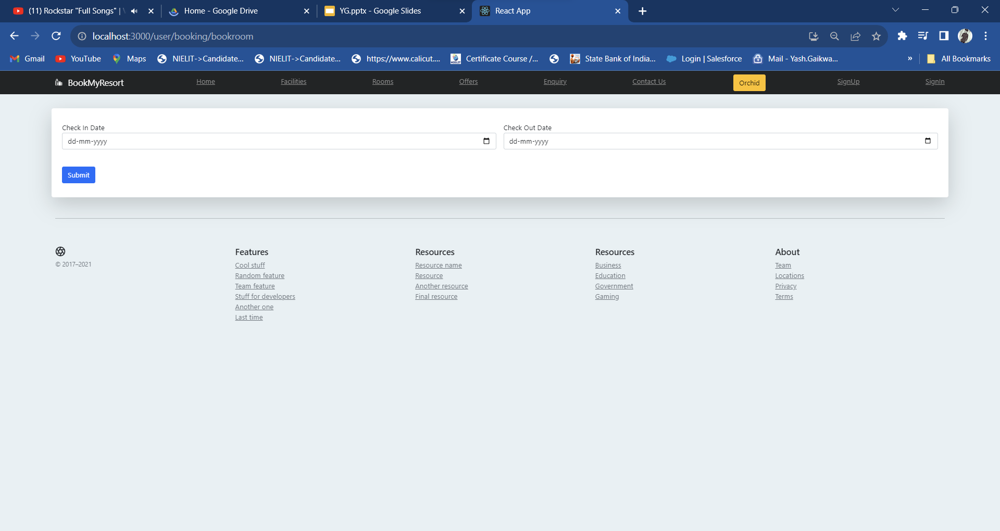
User Interface(Conti..)
‹#›
‹#›

Slide 18
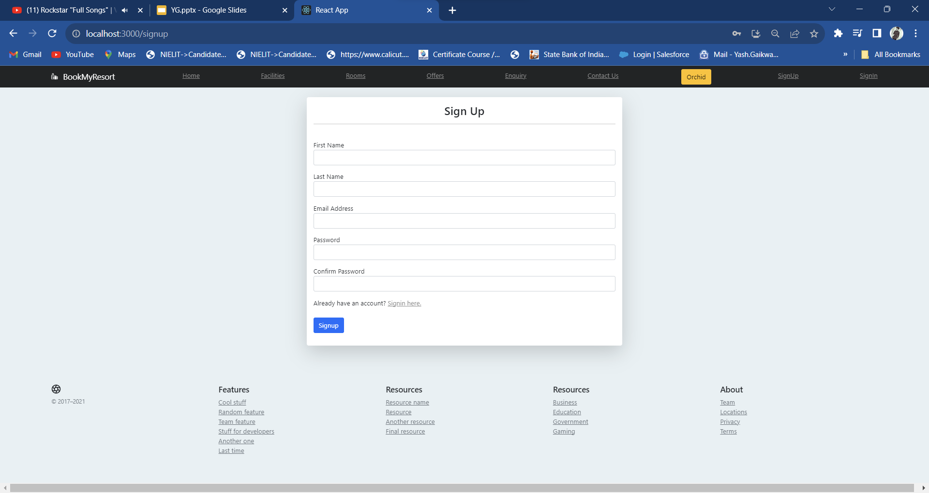
User Interface(Conti..)
‹#›
‹#›

Slide 19
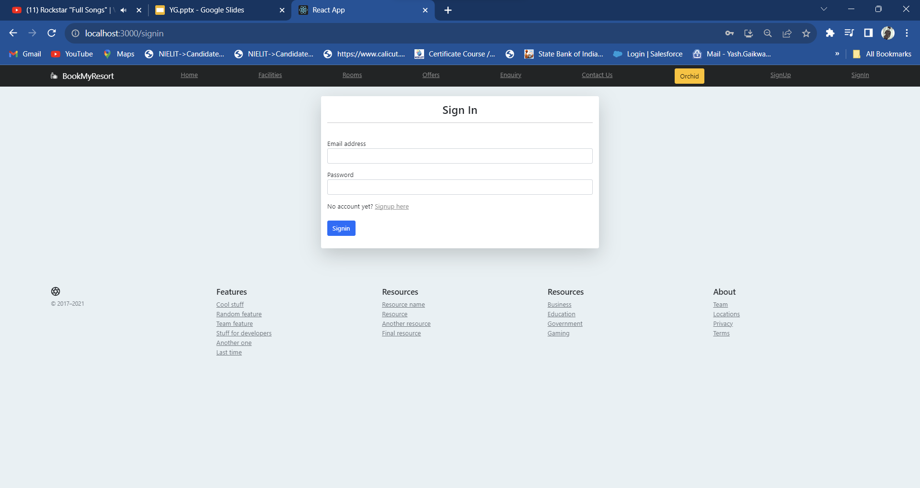
User Interface(Conti..)
‹#›
‹#›

Slide 20
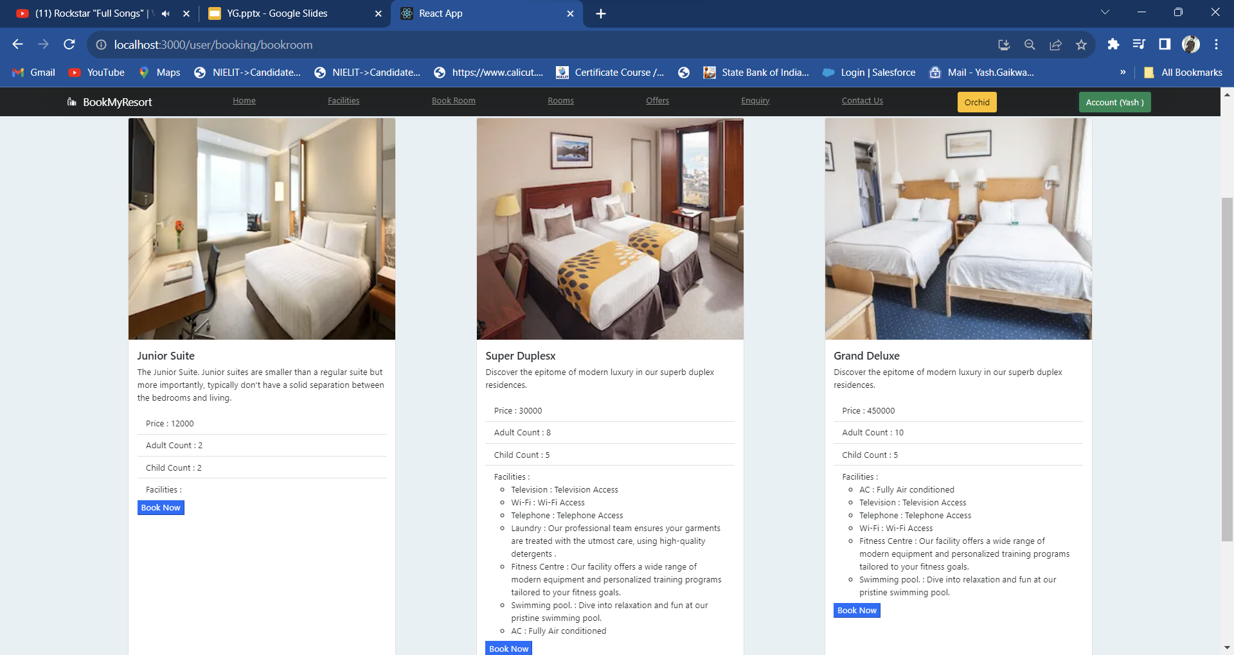
User Interface(Conti..)
‹#›
‹#›

Slide 21
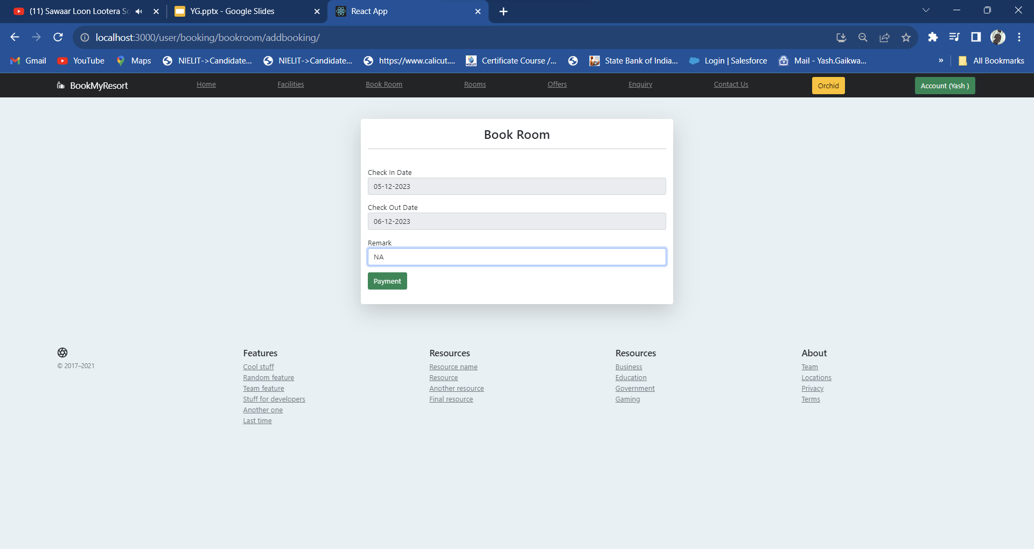
User Interface(Conti..)
‹#›
‹#›

Slide 22
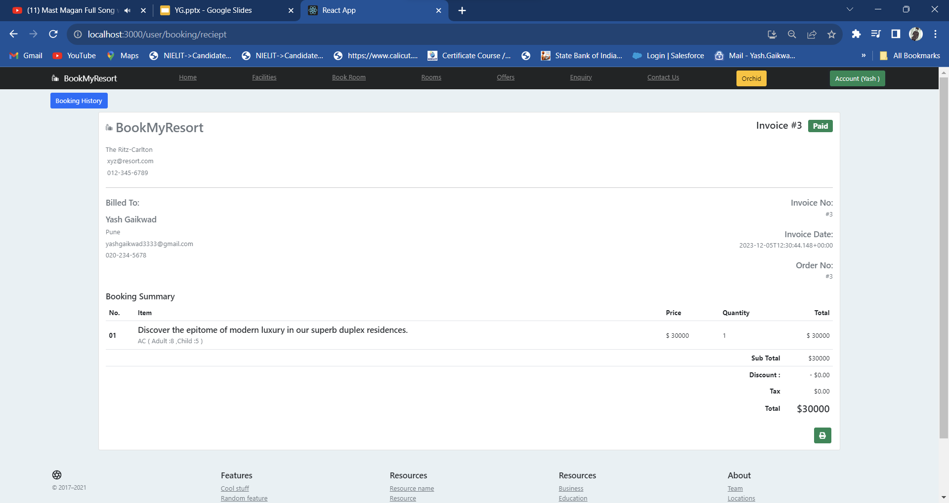
User Interface(Conti..)
‹#›
‹#›

Slide 23
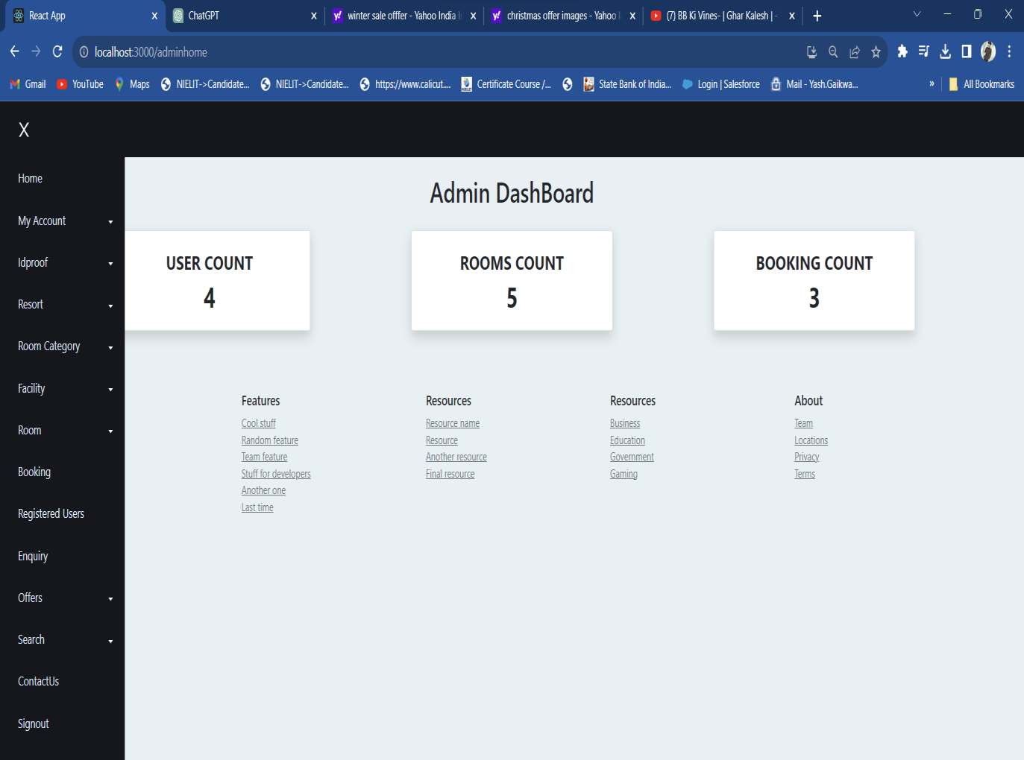
User Interface(Conti..)
‹#›
‹#›

Slide 24
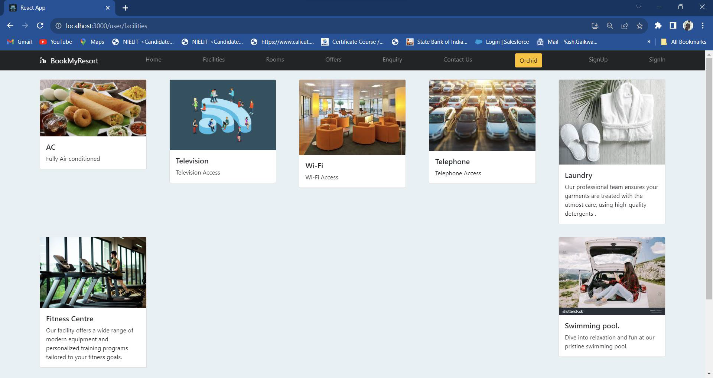
User Interface(Conti..)
‹#›
‹#›

Slide 25
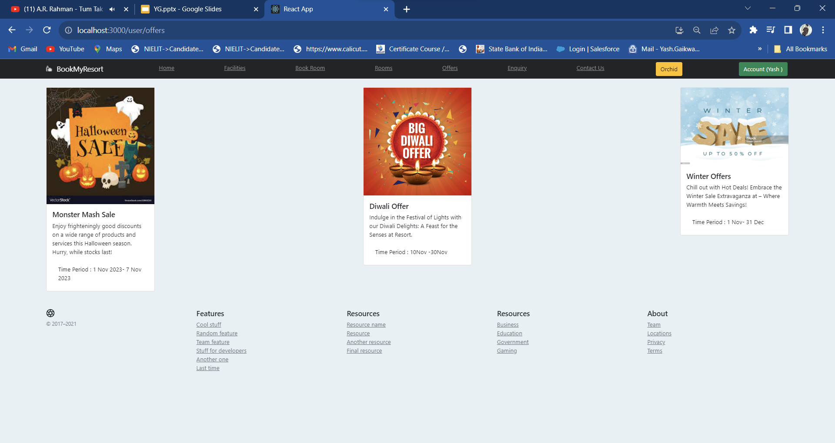
User Interface(Conti..)
‹#›
‹#›

Slide 26
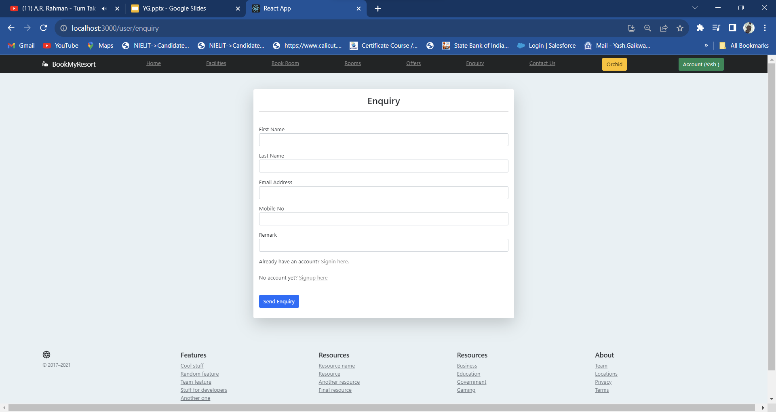
User Interface(Conti..)
‹#›
‹#›

Slide 27
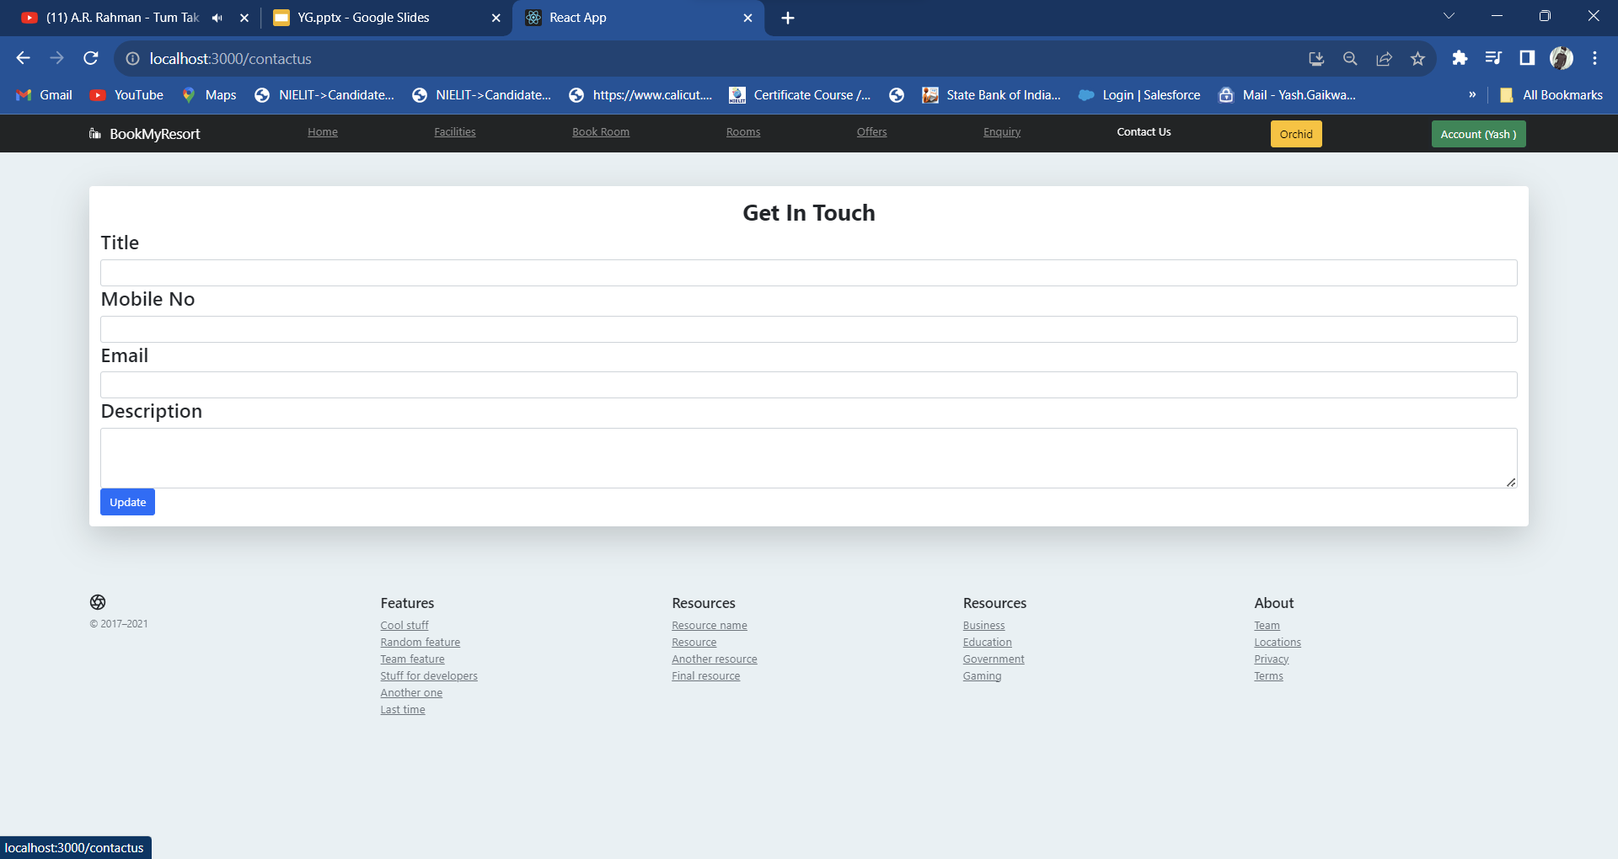
User Interface(Conti..)
‹#›
‹#›

Slide 28
Conclusion
Web based Application.
Faster Performance.
Build on Native Platform.
Less Cost.

Slide 29
Thank you!
‹#›

